Slide 1
Breast Cancer prediction (bcp) Project

Slide 2
Introduction
Breast Cancer (BC) – is a type of cancer that starts in the breast. And this type of cancer starts when cells begin to grow out of control – which usually forms a tumor that can often be seen on an x-ray or felt as a lump and most of these lumps are benign and/or not cancer (malignant) [1]. All over the world, BC has been identified as one of the most widespread cancers amongst women and the major cause of female cancer death. Doctors and researchers alike have been focused on the timely detection of cancer as it spreads in surrounding tissues in the body (Siegel, Miller, & Jemal, 2015) [3]. Hence, the timely detection of cancer is important for the survival rate after undergoing cancer treatment [1].
In this project, I will be using the dataset from UCI Irvine Machine Learning Repository (UCI) to see how well we can accurately detect and/or classify if a tumor is malignant or benign
I decided to use this dataset for my first project on machine learning, since it’s a very straightforward dataset with no missing values and all variables being real-valued (no categorical variables). Number of attributes for each patient: 31

Slide 3
DATA USED FOR THE PROJECT
The dataset contains about 569 samples and 31 features computed from digital images. Each sample identifies parameters of each patient.
For example:
diagnosis
radius
Texture
Etc.,

Slide 4
Data Processing
The raw data collected for data analysis may be incomplete, noisy, or inconsistent. Incomplete data may be the result of some values missing for some attributes, the lack of data for interesting attributes, or the availability of only aggregate data.
Hence, due to the time limitation that we have in other to get the project completed, there were no much-preprocessing steps – such as data cleaning, data transformation, and data discretization that was carried out on this dataset.

Slide 5
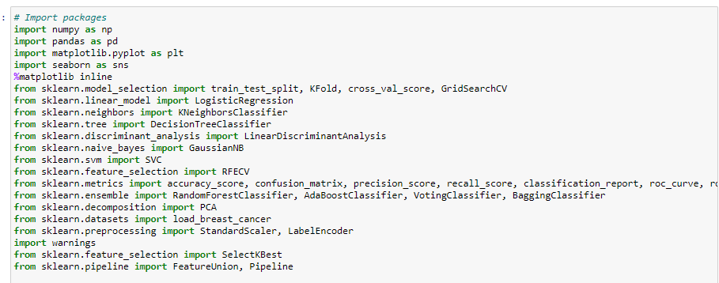
Packages used
Sklearn
Ensemble
Linear model,
naive_bayes
Etc.
numpy
pandas
Seaborn
Finally, custom package called “data_reader”
Notes:
Other packages can be found in the project file.

Slide 6
Classification Models
Here are Some of the classification models that was used in this project are:
Logistic Regression
KNN
Random Forest
votingclassification
Decision Tree
Etc.,

Slide 7
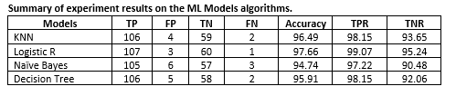
Building Models
KNN:
171 records
Accuracy: 96.49%
Mislabeled: 6
Logistic:
171 records
Accuracy: 97.66
Mislabeled: 4
Decision Tree:
171 records
Accuracy: 94.74
Mislabeled: 4
Notes:
If interested in learning more about the implementation of the entire classifications model please do to not hesitate in referencing the code file of the project which in fact contains all the steps and codes line by line on how & what steps was taken in obtaining such high accuracies.

Slide 8
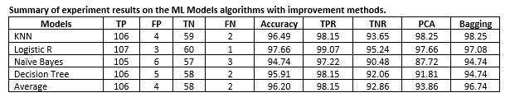
Performance/Improvement
Principle Component Analysis (PCA)
KNN: Increased with about 2%
Accuracy: 98.25%
Logistic: did change
Accuracy: 97.66%
Bagging Classification method:
KNN:
Accuracy: 98.25%
Logistic: remain same
Accuracy: 97.66%
Notes:
There was a slight improvement in accuracies – especially with kNN.
Dimension did not improve Logistic nor did it help in way to improve the rest of the models.

Slide 9
Observations
Logistic Regression was the ONLY classifier that was performing great initially before some improvement methods was applied.
kNN then out-performed the other model after PCA and Bagging was applied.
Therefore, there were a slightly improvement when PCA and bagging was applied. And, we can also clearly see this behavior from the ROC curve.

Slide 10
In conclusion
Overall, outcome and experience of this project has been truly great.
I have learnt a lot
How to train models
Compare different type of models
Evaluate model performance.
Improve on model accuracies.
Finally, my best model (kNN) was able to correctly predict breast cancer dataset with a 98% accuracy.

Slide 11
Q&A
Note: All code related questions can easily be answered by visiting the project directory.
?

